Slide 1
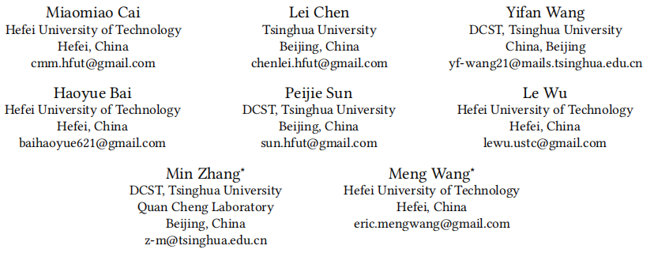
Popularity-Aware Alignment and Contrast for Mitigating
Popularity Bias
（KDD-2024 code)
Reported by Jiale Shen

Slide 2
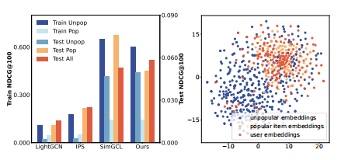
motivation
（1) how to extract common supervision signals from popular items to improve the unpopular item representations.
(2) how to alleviate the representation separation caused by popularity bias.

Slide 3
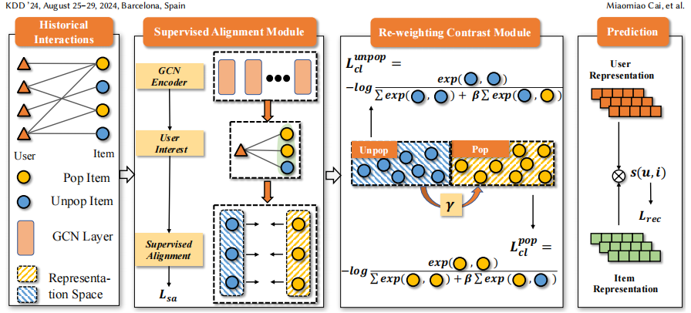
Overview
Q1:extract common supervision signals
Q2:alleviate the representation separation

Slide 4
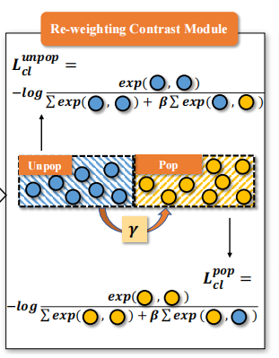
Overview

Slide 5
Approach

Slide 6
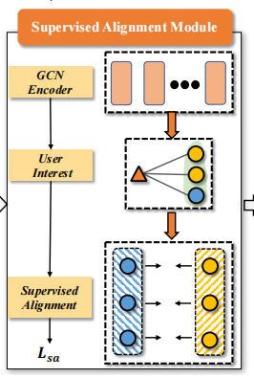
Approach

Slide 7
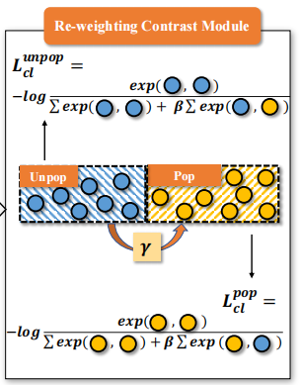
Approach

Slide 8
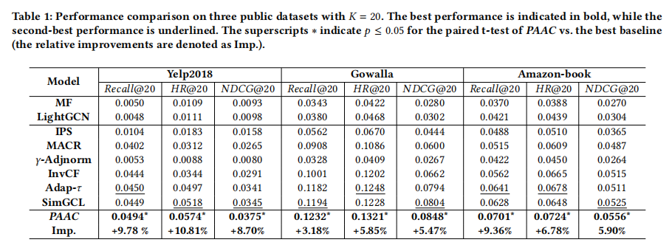
Experiment

Slide 9
Experiment

Slide 10
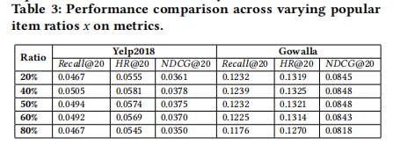
Experiment

Slide 11
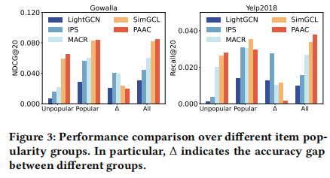
Experiment

Slide 12
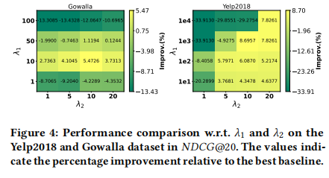
Experiment

Slide 13
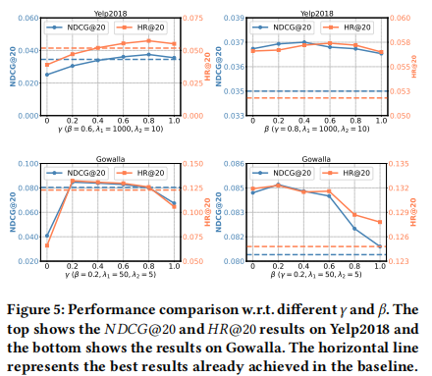
Experiment

Slide 14
Thank you!

